Slide 1

Computer Architecture Experiment
Xiaohong Jiang
College of Computer Science & Engineering
Zhejiang University

Slide 2
Topics
0、Basic Knowledge
1、Function Units Design
2、Single-cycle CPU Design
3、Multiple-cycle CPU Design
4、5-stage of pipeline CPU Design
5、Pipelined CPU with stall
6、Pipelined CPU with forwarding
7、Pipelined CPU resolving control hazard
8、Pipelined CPU support execution 31 MIPS Instructions
10、Course Review

Slide 3
Outline
Experiment Purpose
Experiment Task
Basic Principle
Operating Procedures
Precaution

Slide 4
Experiment Purpose
Understand the principles of MC CPU Controller and master methods of MC CPU Controller design
Understand the principles of Datapath and master methods of Datapath design
Understand the principles of MC CPU and master methods of MC CPU design
master methods of program verification of CPU

Slide 5
Experiment Task
Design the CPU Controller, Datapath, bring together the basic units into Multiple-cycle CPU
Verify the MC CPU with program and observe the execution of program

Slide 6
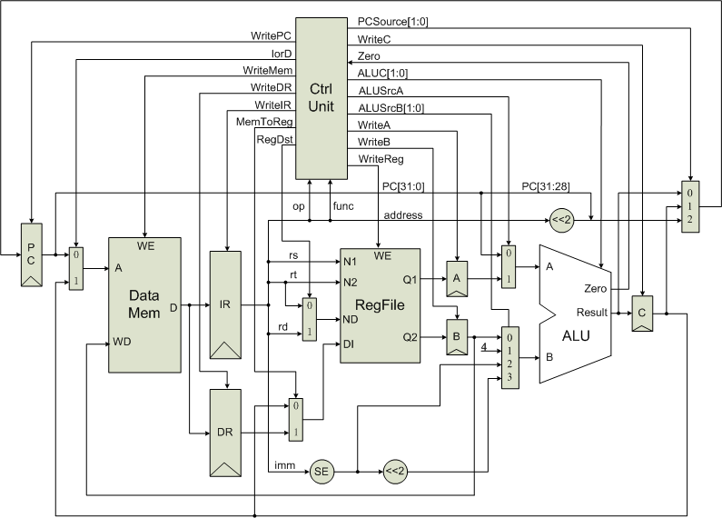

CPU Controller

Slide 7
Output of CPU Controller
 | Output Signal | Meaning When 1 | Meaning When 0
1 | PCSrc[1:0] | 00: PC + 4;01: Branch Instr.;10: jump Instr
2 | WritePC | Write PC | Not Write PC
3 | IorD | Instruction Addr | Data Addr.
4 | WriteMem | Write Mem. | Not Write Mem.
5 | Write DR | Write Data. Reg | Not Write Data. Reg
6 | Write IR | Write Instr. Reg | Not Write Instr. Reg
7 | MemToReg | From Mem. To Reg | From ALUOut To Reg
8 | RegDest | rd | rt
9 | ALUC | ALU Controller Op
10 | ALUSrcA | Register rs | PC
11 | ALUSrcB | Selection:00:Reg rt; 01:4; 10:Imm.; 11: branch Address
12 | WriteA | Write A Reg. | Not Write A Reg.
13 | WriteB | Write B Reg. | Not Write B Reg.
14 | WriteC | Write C Reg. | Not Write C Reg.
15 | WriteReg | Write Reg. | Not Write Reg.

Slide 8
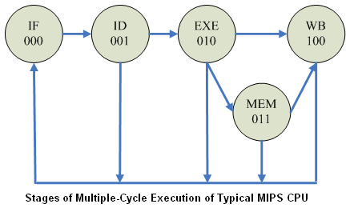
The principle of CPU Controller(1)

Slide 9
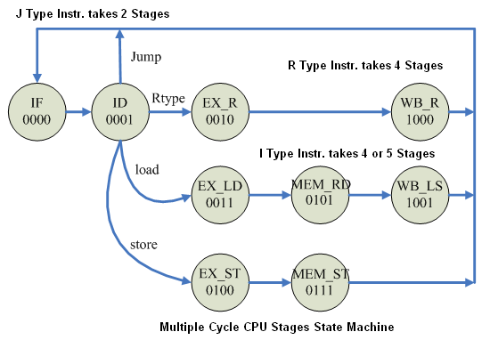
The principle of CPU Controller(2)

Slide 10
The Datapath of Multiple-cycle CPU

Slide 11
Basic Units of Multiple-cycle CPU
CPU Controller
ALU and ALU Controller
Register file
Mem. (Instruction and Data together).
others：Register, sign-extend Unit, shifter, multiplexor

Slide 12
Memory
Memory
  Dual Port Block Memory
  Port A: Read Only, Width: 32, Depth: 512
  Port B: Read and Write, Read After Write
  Rising Edge Triggered

Slide 13
Multiple-cycle CPU Top Module
memory x_memory(.addra(raddr),.addrb(waddr),.clka(clk), .clkb(clk),.dinb(b_data),.douta(mem_data),.web(write_mem));
ctrl x_ctrl(clk, rst, ir_data, zero,write_pc, iord, write_mem, write_dr, write_ir, memtoreg, regdst, pcsource, write_c, alu_ctrl, alu_srcA, alu_srcB, write_a, write_b, write_reg, state_out, insn_type, insn_code, insn_stage);
pcm x_pcm(clk, rst, alu_out, c_data, ir_data, pcsource, write_pc,pc);
alu_wrapper x_alu_wrapper(a_data, b_data, ir_data, pc, alu_srcA, alu_srcB, alu_ctrl, zero, alu_out);
reg_wrapper x_reg_wrapper(clk, rst, ir_data, dr_data, c_data, memtoreg, regdst, write_reg, rdata_A, rdata_B, r6out);

Slide 14
Observation Info
Input
  West Button: Step execute
  South Button: Reset
  Slide Button: Address of Register
Output
  0-7 Character of First line: Instruction Code
  8 of First line : Space
  9-10 of First line : Read Address
  11 of First line : Space
  12-13 of First line : Write Address
  0/2/4/6 of Second line : state/type/code/stage
  8-9 of Second line : PC
  11-14 of Second line: Selected Register Content

Slide 15
Program for verification
<0> lw r1, $20(r0); 0x8c01_0014 State:0,1,3,5,9 Type:3 Code:1 (LD)
<1> lw r2, $21(r0); 0x8c02_0015 State:0,1,3,5,9 Type:3 Code:1 (LD)
<2> add r3, r1, r2; 0x0022_1820 State:0,1,2,8 Type:1 Code:3 (AD)
<3> sub r4, r1, r2; 0x0022_2022 State:0,1,2,8 Type:1 Code:4 (SU)
<4> and r5, r3, r4; 0x0064_2824 State:0,1,2,8 Type:1 Code:5 (AN)
<5> nor r6, r4, r5; 0x0085_3027 State:0,1,2,8 Type:1 Code: 6 (NO)
<6> sw r6, $22(r0); 0x ac06_0016 State:0,1,4,7 Type:3 Code: 2 (ST)
<7> J 0; 0x0800_0000 State:0,1 Type:2 Code:7 (JP)
DataMem(20) = 0xbeef_0000 ;
DataMem(21) =0x0000_beef ;

Slide 16
Precaution
1. Add Anti-Jitter
2. Finish the State Machine
3. Add Stage Status
Report:
To make the content of report fit, program source code could be zipped and transferred to the same fold of FTP Server. In the report, you could write only the modified source code.

Slide 17
Thanks!

